Slide 1


Specification, Partitioning, and Composition Techniques for Web Applications in the Context of Event-B
Abdolbaghi Rezazadeh
Michael Butler
University of Southampton

Slide 2
Overview
Event-B supports abstraction of services to business level
Refinement/decomposition to distributed architecture
  refinement introduces architecture
Can we have structure in the abstraction and how is this structure related to implementation structure?

Slide 3
End-to-end service contract
How it is implemented:
Partner
Partner
Partner
Middleware

Slide 4
Abstract spec of balance transfer
TransferOk =
when bal(p1) ≥ a then
bal(p1) := bal(p1)-a || bal(p2) := bal(p2)+a end
LoseValue =
when bal(p1) ≥ a then
bal(p1) := bal(p1)-a || lost(p1) := lost(p1)+a end
Recover =
when lost(p1) ≥ a then
bal(p1) := bal(p1)+a || lost(p1) := lost(p1)-a end

Slide 5
Protocol steps (Mondex)
Source purse
Target purse
req
epr
decrease balance p1
epv
val
epa
increase balance p2
ack
end
end
Also: a transaction can be aborted at any point
Abort caused by timeout or by card removal

Slide 6
Substantial Requirements
Quality considerations
- performance
- scalability
reusability
maintainability
Functional requirements
- clients
- users
- other stakeholders
Web Applications
Experience with
- existing architecture
- patterns
- project management
Technical aspects
- operating system
- middleware
- legacy-systems
Factors influencing the development of Web Applications

Slide 7
Event-B
State-transition model (like ASM, B, VDM, Z)
  set theory as mathematical language
Refinement
  state reification
  one-to-many event refinement
  new events (stuttering steps)
Proof method
  Refinement proof obligations (POs) generated from models
  Automated and interactive provers for POs
  Proof feeds back into modelling

Slide 8
Rodin Tool for Event-B www.event-b.org
Extension of Eclipse IDE (Java based)
Open source – managed on sourceforge
Repository of modelling elements
  Abstract syntax as Java objects, XML files
  Allow for easy extension of abstract syntax
Rodin Eclipse Builder coordinates:
  Well-formedness + type checker
  PO generator
  Proof manager
  Propagation of changes
Collection of additional plug-ins
  ProB, UML-B, AnimB, ReqMan

Slide 9
Need for more structuring in Event-B
Technical Aspects
  To comply with layering architecture of Web applications
  To deal with issues like separation of concerns
    e.g., specify security and business logic separately
Support for Team-based Development and reusability
  Delegation of subsystems development tasks to sub-groups
  Supporting reusability and pattern-based development

Slide 10
Web Application Structure
Multi-layer Architecture to achieve:
  High level of modularity
  Separation of concerns
  Effective way to handle complexity
User Tier
(standard Bowser)
Web Server
Application
Server
Back-end
or
Database Systems

Slide 11
Extending current methodology
Identifying reoccurring composition patterns
  These patterns can be domain-specific like Web Applications
Classifying recognised patterns
  This may involve some informal representation
Formally model these patterns
Providing some examples how these patterns can be used
  Both in non-formal and formal Event-B
We outline some of these composition patterns

Slide 12
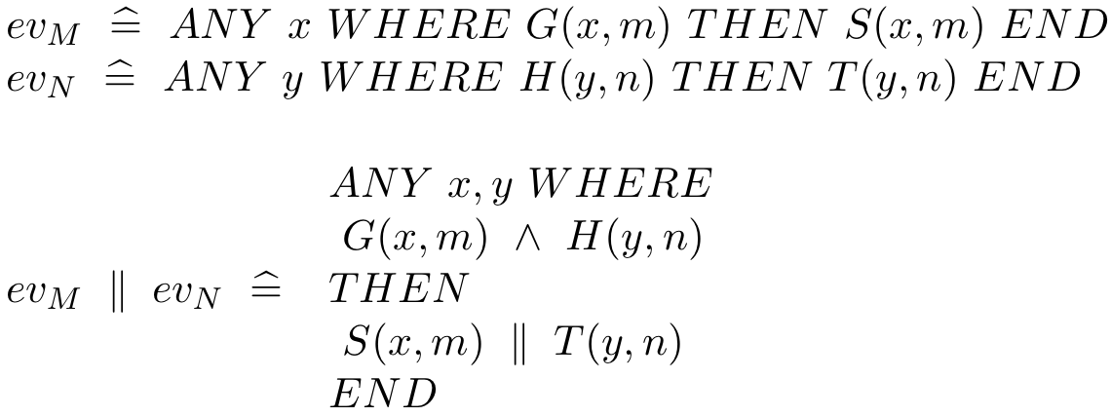
Devising composition mechanism in Event-B
Composition Patterns
  Basic Parallel Composition Mechanism (Pattern 1)
Machine M
Machine N
ev_{M}
ev_{N}

Slide 13
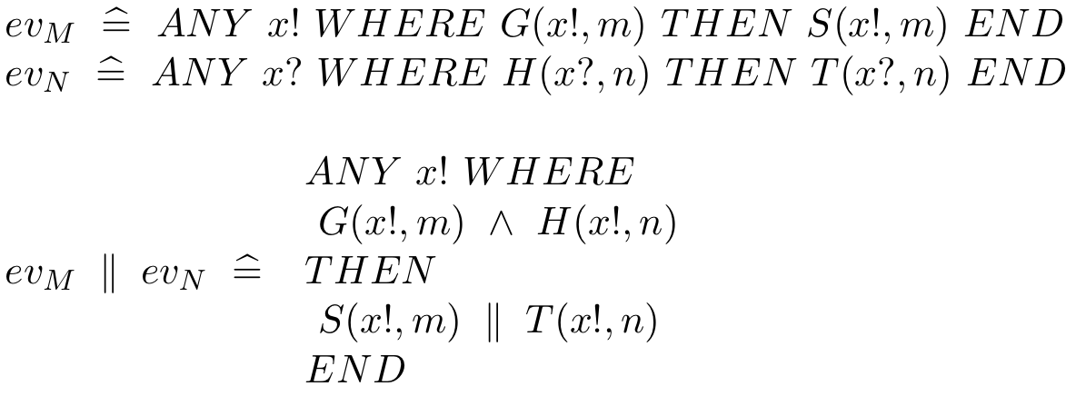
Parallel composition with value-passing (Pattern 2)
    One output event and one input event
Machine M
Machine N
ev_{M}
x!
ev_{N}

Slide 14
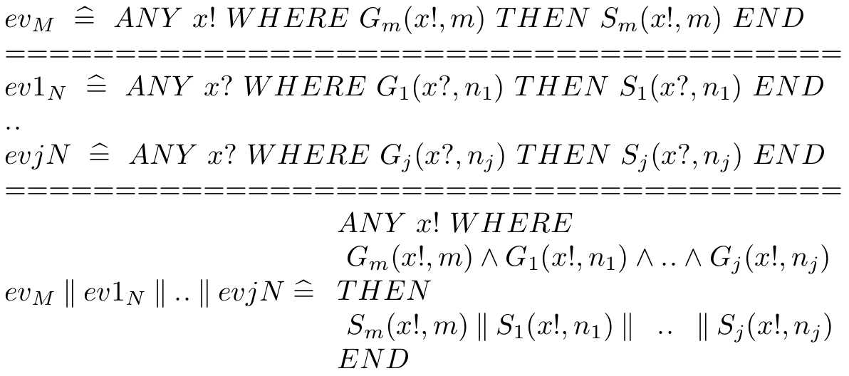
  Broadcasting composition (Pattern 3)
A single output event which synchronises with many input events
ev1_{N}
x!
ev2_{N}
ev_{M}
ALL
:
evj_{N}
Machine M
Machine N

Slide 15
Alternation patterns
Machine M
Machine N
x!
evj_{N}
ev1_{N}
:
x!
ev2_{N}
ev_{M}
OR
ev_{M}
OR
ev2_{N}
:
ev1_{N}
evj_{N}
Machine M
Machine N
One output event with one of many input events (Pattern 4)
One of many output events with one input event (Pattern 5)

Slide 16
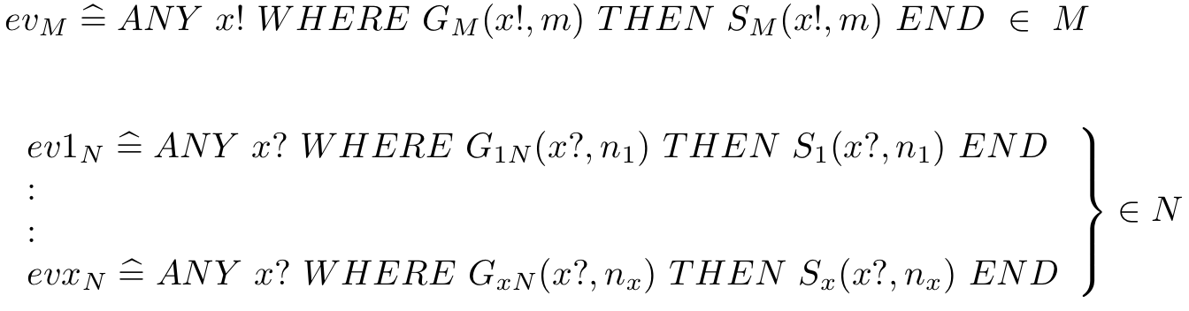
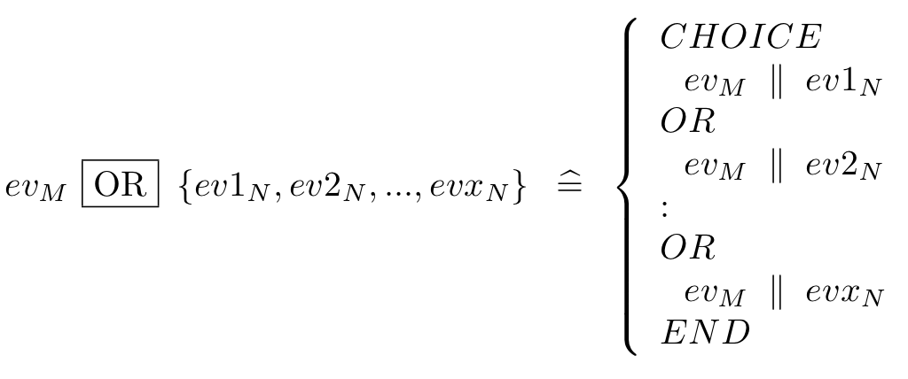
  Formal presentation of Choice composition (Pattern 1)

Slide 17
Preserving Composition Structure
M
N
ev_{M}
x!
ev_{N}
Refined to
M’
N’
ev_{M}
ev_{N}
x!
x?
Communication layer

Slide 18
Transverse Composition Structure
M
N
ev_{M}
ev_{N}
Refined to
M1+N1
M2+N2
Communication layer

Slide 19
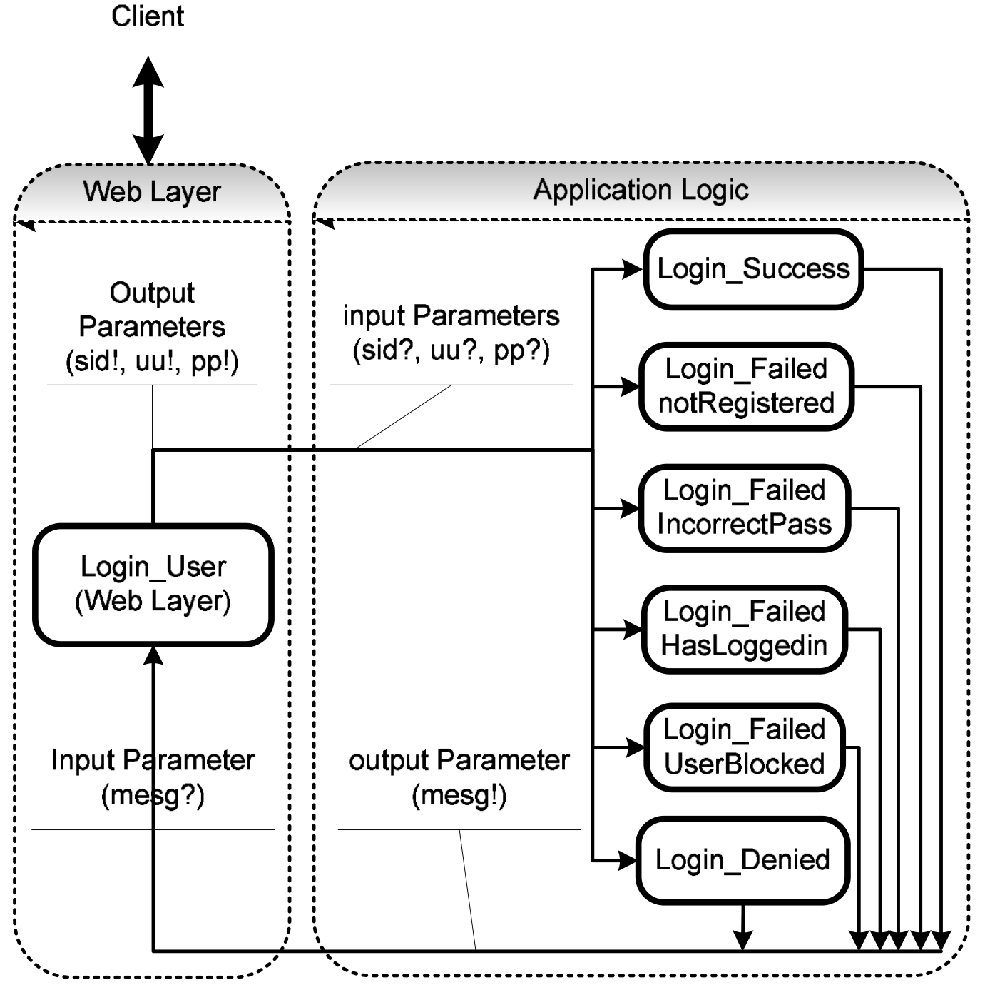
Login Scenario From the Auction System
An example of Choice Composition
(Pattern 3)
Parameters
sid : Session ID
uu : User Name
pp : Password

Slide 20
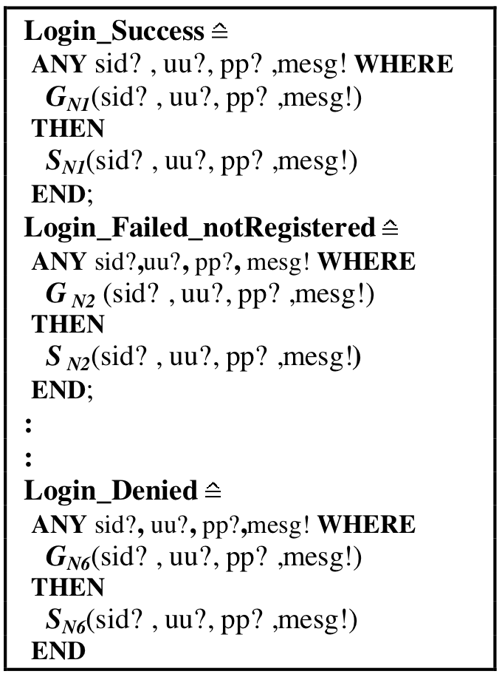

Representation of Login Scenario
Login scenario
Web Layer
Login scenario
Application Layer

Slide 21
Conclusions
We identified some composition patterns and formally modelled them
An example for using composition pattern has been provided
Using these composition patterns can pave the way for more reuse
Formal Composition patterns should be investigated in more depth

